Slide 1
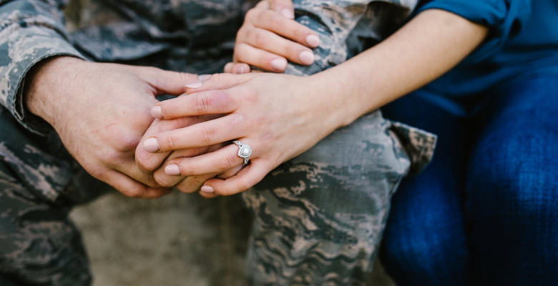
Supporting Veterans and Military Families: Moral injuries of war
Chenal-Christine N. Roberts University of Colorado, College of Nursing NURS 6017 (I01) – On the Home Front: Supporting Veteran and Military Families Dr. Mona Pearl Treyball Final - May 2023

Slide 2
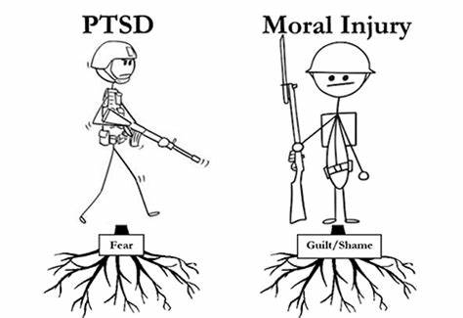
Abstract
Veterans are returning home to their families with invisible wounds or moral injuries, and these injuries can be life changing not only for themselves, but for their families. Though moral injury is less known and talked about vs. PTSD, TBI or suicide, it relates to all of them and can be just as life altering.
Resources are available for those experiencing moral injuries, yet our Veterans and their families are unaware of them, like most other VA modalities for our wounded Veterans. Growing as a nurse, I have found truth and understanding in the phrase “sharing is caring” and strive to find ways for what can we do to help and support. Our jobs as nurses and healthcare providers is to turn our way of thinking into what else can we do to help, while also educating Veterans and their families on options readily available.

Slide 3
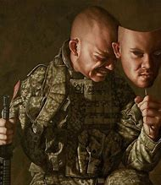
Moral injury… is it real?
Unlike PTSD or depression, moral injury is not a diagnosable disorder or clinical condition. Instead, moral injury is an internal experience that results from being directly involved or witnessing situations that violate deeply held beliefs or moral values. Though “moral injury syndrome” doesn’t exist due to little being currently known about its prevalence, etiology, and symptoms to accurately define it, especially since moral injuries are subjective to each person.
According to Held, et.al. (2017) proponents of “moral injury syndrome” have proposed three features, which include (a) the experience of events that cause significant moral dissonance; (b) the presence of core symptoms, such as guilt, shame, spiritual or existential conflicts, and a loss of trust in self, other, or ultimate/transcendental beings; and (c) the presence of secondary symptoms, such as depression, anxiety, anger, re-experiencing of the moral conflict, or social problems

Slide 4
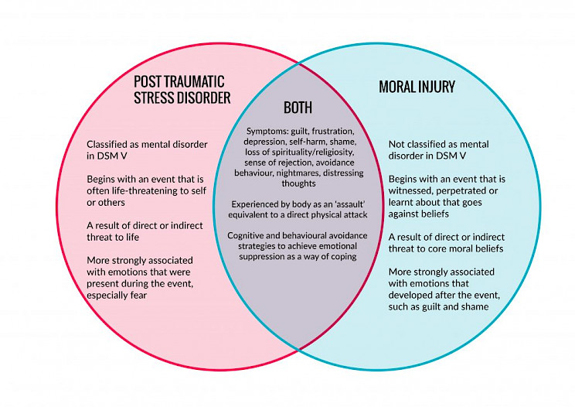
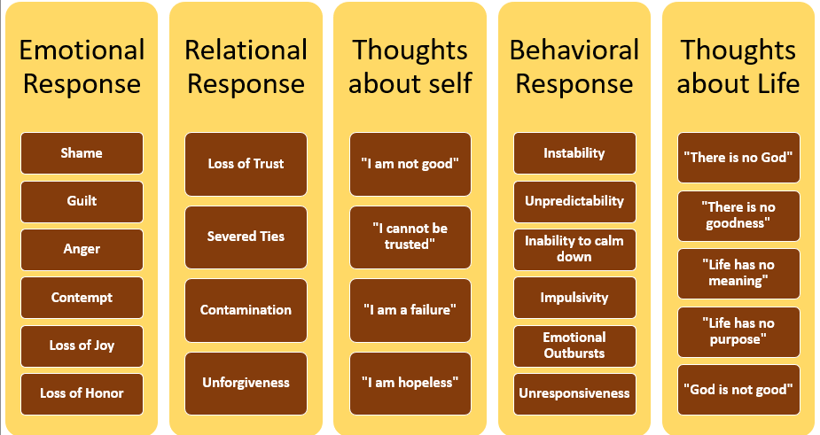
Ways to understand the affects of moral injury

Slide 5
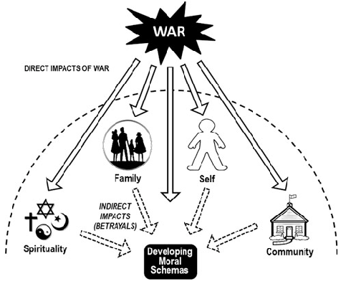
Connections of moral injury
When people feel disconnected or isolated from others negative thoughts, feelings, and emotions can creep in, wreaking havoc on a person's mental health. Veterans and their family might find themselves experiencing anxiety, depression, feelings of guilt from service or being absent from home. This doesn’t just affect the Veteran. Family can experience similar issues because they may be struggling with being home while their significant other risks everything. How does this compare with increased responsibilities at home and how does this help when trying to be able to support their Veteran.
Additionally, risk of major depressive disorder (MDD)can lead to moral injury in military spouses, especially when managing home and family and then having the addition of their service members psychological disorders upon returning home.

Slide 6
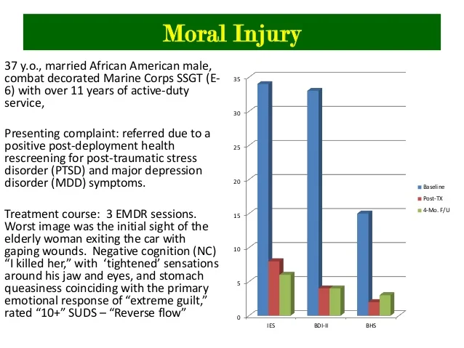
Getting started
Moral injury is not considered a mental illness. However, an individual's experiences of moral injury events can cause profound feelings of shame and guilt, and alterations in cognitions and beliefs (i.e., “I am a failure” “I can’t manage this house and family”), as well as maladaptive coping responses (eg, substance misuse, social withdrawal, or self-destructive acts). It is these challenged beliefs and altered thoughts that are thought to lead to the development of mental health problems.
Researchers of moral injury have developed two separate self-report assessments: the 11-item Moral Injury Events Scale (MIES; 9) and the 20-item Moral Injury Questionnaire—Military Version (MIQ-M; 7). Both scales assess the degree to which service members either were directly involved or witnessed potentially morally injurious war-zone events, and both scales have sound psychometric properties. The MIES and MIQ-M are both highly correlated with psychopathology, including PTSD and depression, as well as other psychological factors, such as adjustment and suicide risk, and measures of trauma and combat experiences.
*7. Currier JM, Holland JM, Drescher K, et al.: Initial psychometric evaluation of the Moral Injury Questionnaire--Military version. Clin Psychol Psychother 2015; 22:54–63 [PubMed])
*9. Nash WP, Marino Carper TL, Mills MA, et al.: Psychometric evaluation of the Moral Injury Events Scale. Mil Med 2013; 178:646–652 [PubMed] )
Brock, Rita Nakashima (2012, July 23). MORAL INJURY: The Crucial Missing Piece in Understanding Soldier Suicides [photograph], Huffington Post.

Slide 7
Examples of treatment strategies (Litz, et.al. 2009)
Step one: Connection
The genuine relationship of the therapist to the patient and the story he or she is telling will be a critical component of how the event comes to be experienced.
Step two: Preparation and education
Step three: Modified exposure component
Throughout the process, therapists needs to be fully engaged and directive to encourage, support, prompt, provoke, and cue the patient to process particularly painful elements so that meanings, needs, and motivations can be discovered and examined.
Step four: Examination and integration
While processing and dialoguing about the meaning and implication of events, it is also important for individuals to be able to express remorse and to reach their own conclusions about the causes of the events, albeit with guidance from the therapist.
Step five: Dialogue with a benevolent moral authority
Goals to have patients verbalize what they did or saw, how this affects them, and what they think should happen to them (or others) as a result.
Step six: Reparation and forgiveness
Making amends means drawing a line between past and present and in some way changing one's approach to how he or she behaves and acts so that one moves towards the positive, towards better living.
Step seven: Fostering reconnection
consistent with mindfulness approaches to trauma care; patients should be encouraged to engage in group activities and/or spiritual communities
Step eight: Planning for the long haul
what would patients like to see for themselves and the people they care about over the long haul, considering their values?
Patients need a model or plan of action to guide the difficult work ahead

Slide 8
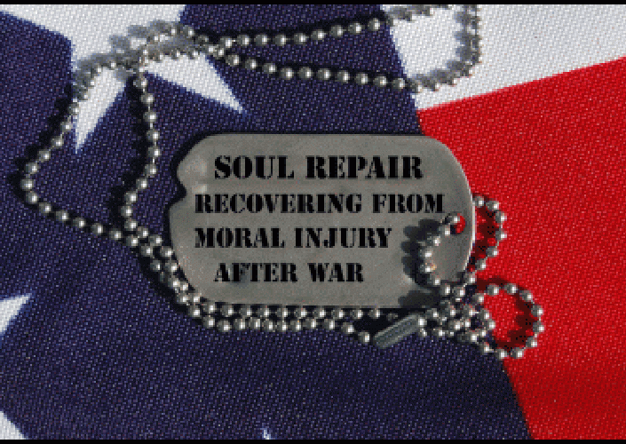
There are still extensive limitations when acknowledging and treating moral injury. Moral injury debilitates people, preventing them from living full and healthy lives. The effects of moral injury go beyond the individual and can destroy one’s capacity to trust others, impinging on the family system and the larger community. First, moral injury remains difficult to treat because existing tools are not available for use in non-military populations and most options are not recognized for valid for medical use and documentation.
Additionally, there is no system for ensuring that the spouses and their service members with PTSD, depression, anxiety, or alcohol problems are offered additional supportive services. Treating patients with mental health issues caused by moral injuries can be challenging and, in some areas, non-existent due to the minimal understanding and practice of treatment. Some might try exposure-based therapy (EBT), but this can be harmful if attention is not properly focused on the emotional processing of feelings like shame and guilt. Other approaches that focus on self-forgiveness, acceptance, and self-compassion might hold more promise. Moral injury must be brought forward into the community for a shared process of healing.

Slide 9
References
Bartone, P. T., & Homish, G. G. (2020). Influence of hardiness, avoidance coping, and combat exposure on depression In returning war veterans: A moderated-mediation study. Journal of affective disorders, 265, 511–518. https://doi.org/10.1016/j.jad.2020.01.127
Claire Houtsma, Lauren R. Khazem, Bradley A. Green, Michael D. Anestis, Isolating effects of moral injury and low post-deployment support within the U.S. military, Psychiatry Research, Volume 247, 2017, Pages 194-199, ISSN 0165-1781, https://doi.org/10.1016/j.psychres.2016.11.031.
Currier, J. M., Drescher, K. D., & Nieuwsma, J. (2021). Introduction to moral injury. In J. M. Currier, K. D. Drescher, & J. Nieuwsma (Eds.), Addressing moral injury in clinical practice (pp. 3–18). American Psychologic Association.
https://doi.org/10.1037/0000204-001
Donoho, C. J., LeardMann, C., O'Malley, C. A., Walter, K. H., Riviere, L. A., Curry, J. F., & Adler, A. B. (2018). Depression among military spouses: Demographic, military, and service member psychological health risk factors. Depression and anxiety, 35(12), 1137– 1144. https://doi.org/10.1002/da.22820
Finnegan, A., & Randles, R. (2022). Nursing care for the military veteran and their family. Journal of clinical nursing, 31(17-18), e29–e31. https://doi.org/10.1111/jocn.16345
Held, P., Klassen, B. J., Zalta, A. K., & Pollack, M. H. (2017). Understanding the Impact and Treatment of Moral Injury Among Military Service Members. Focus (American Psychiatric Publishing), 15(4), 399–405. https://doi.org/10.1176/appi.focus.20170023

Slide 10
References cont.
Ormeno, M. D., Roh, Y., Heller, M., Shields, E., Flores-Carrera, A., Greve, M., Hagan, J., Kostrubala, A., & Onasanya, N. (2020). Special Concerns in Military Families. Current psychiatry reports, 22(12), 82. https://doi.org/10.1007/s11920-020-01207-7
Phelps, A. J., Adler, A. B., Belanger, S. A. H., Bennett, C., Cramm, H., Dell, L., Fikretoglu, D., Forbes, D., Heber, A., Hosseiny, F., Morganstein, J. C., Murphy, D., Nazarov, A., Pedlar, D., Richardson, J. D., Sadler, N., Williamson, V., Greenberg, N., Jetly, R., & Members of the Five Eyes Mental Health Research and Innovation Collaborative (2022). Addressing moral injury in the military. BMJ military health, e002128. Advance online publication. https://doi.org/10.1136/bmjmilitary-2022-002128
Suzanne Marnocha, "Military Wives' Transition and Coping: Deployment and the Return Home", International Scholarly Research Notices, vol. 2012, Article ID 798342, 8 pages, 2012. https://doi.org/10.5402/2012/798342
Zamir, O., Gewirtz, A. H., Cheng, C. H., Zhang, N., & Lavee, Y. (2020). Psychological distress and communication quality in military couples after deployment to war. Journal of family psychology : JFP : journal of the Division of Family Psychology of the American Psychological Association (Division 43), 34(4), 383–391.

