Slide 1
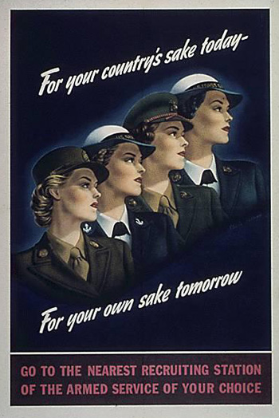
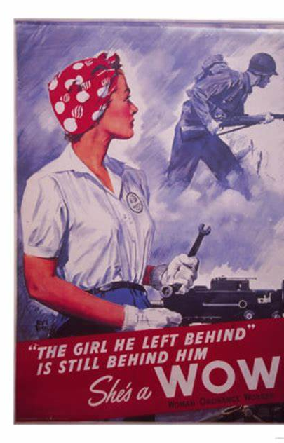
Evolution of Women in War
Chenal-Christine N. Roberts University of Colorado, College of Nursing NURS 6015 - Women and War Dr. Lori Trego Final - July 31, 2022

Slide 2
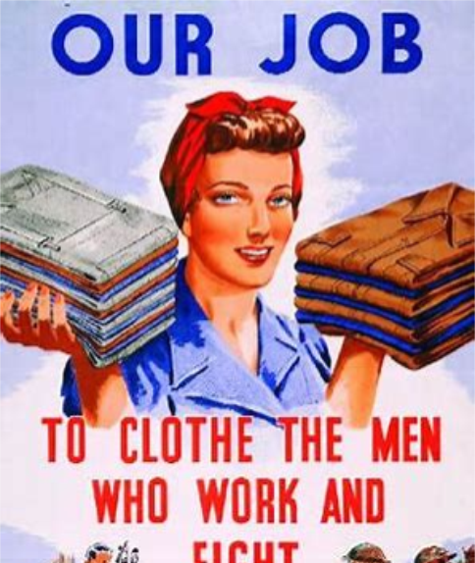
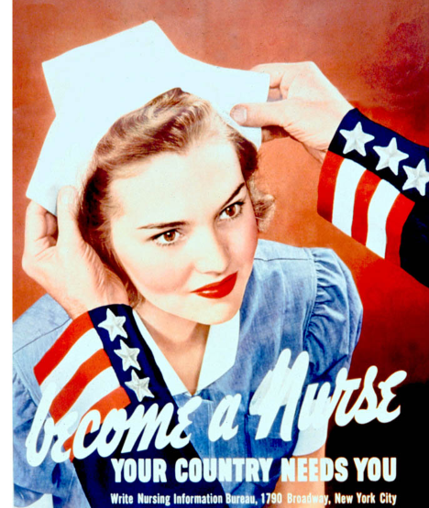
Beginning of an Evolution
The “traditional role” of women in the home has historically been seen as the cook, the nurse and laundress, and these were the roles they were given while helping during war times. They were even expected to walk, talk and dress the part of a lady while doing these jobs. This has thankfully evolved over time.
In 2013, the Secretary of Defense lifted the ban on women serving in combat roles, but when we look back throughout history, women have been serving “unofficially” since before the Revolutionary War. The laws have changed over the years, slowly allowing women access and acceptance into full military positions.
No matter what the hesitance from the political side may be, women have always found a way to serve their country.

Slide 3
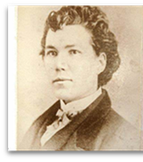
American Revolution Era
The first women to serve in the military did so because their husbands were fighting in the American Revolution. These women were mostly cooks, nurses, and laundresses, but their support roles allowed for combat soldiers to stay healthy on the front lines.
The most noteworthy woman of this time was Deborah Sampson. Pretending to be a man, she served in a Light Infantry unit during the war. She fought in many battles in upstate New York, receiving injuries to her leg and head. She was later discovered as a woman after being injured and treated by a doctor, but her commanding officer, General John Paterson, honorably discharged her and thanked her for her service. During World War II, the Liberty Ship S.S. Deborah Gannett (2620) was named in her honor.

Slide 4
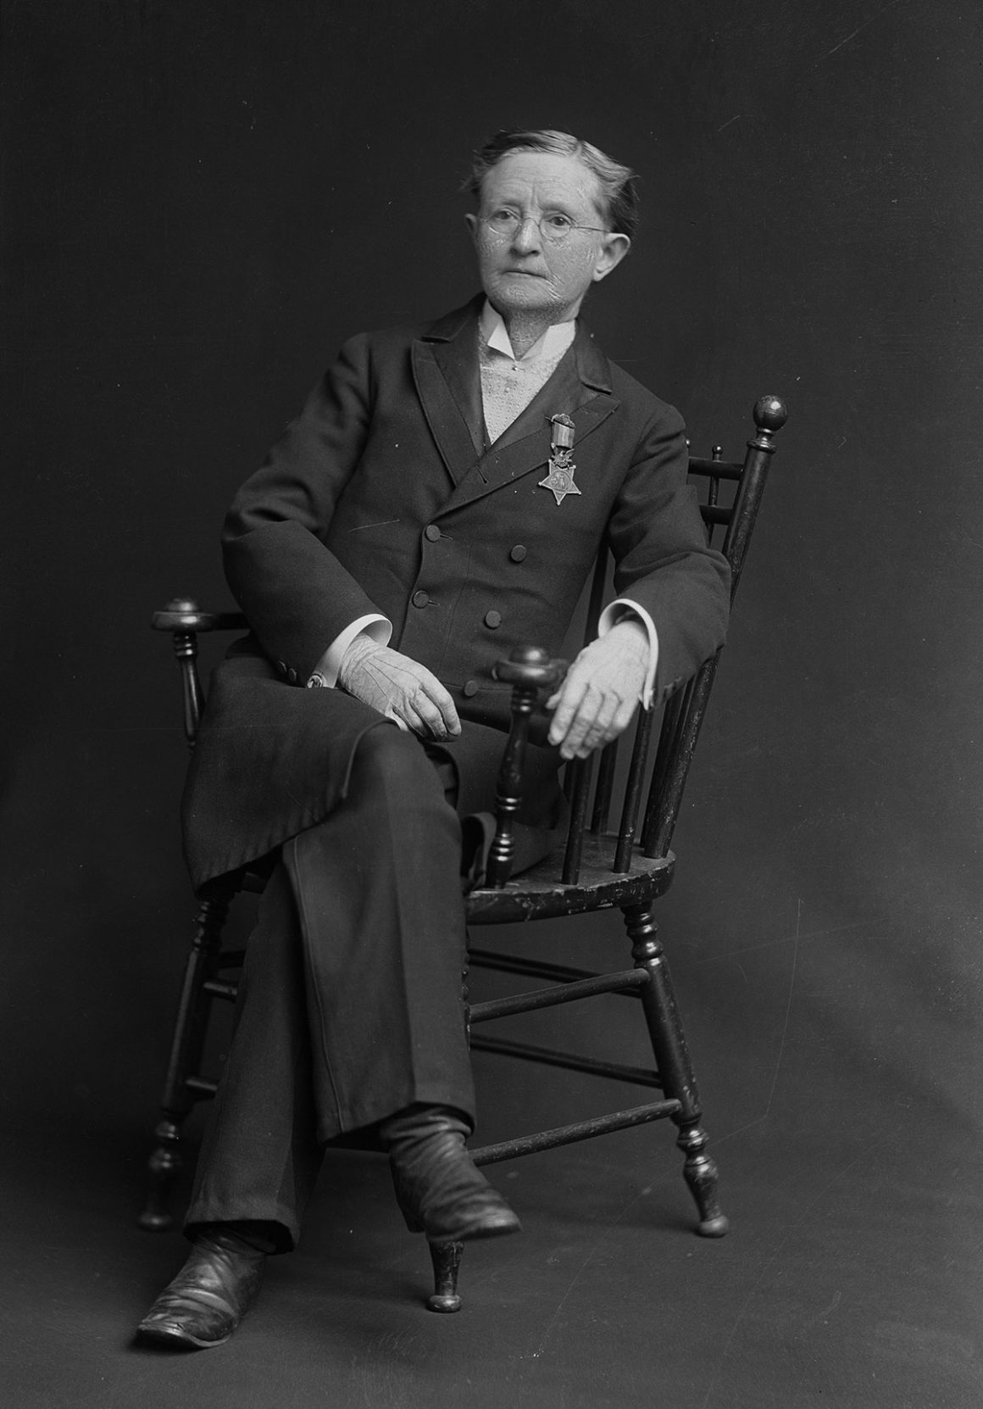
Civil War Era
The American Civil War brought women closer to the front lines than ever before. Battlefield hospitals, were just that, right behind the battle.
Dr. Mary Walker became the first female surgeon in the United States Army, volunteering to serve the Union forces. She worked as a surgeon, crossing enemy lines and helping civilians injured during battle. She was captured by the Confederacy in 1864 becoming a prisoner of war (POW) for several months. Dr. Walker is most famous for becoming the first, and thus far, only woman to be awarded the Congressional Medal of Honor.

Slide 5
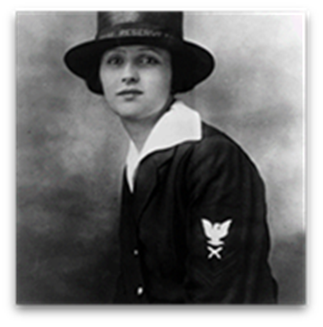
World War I (WWI)
WWI is notable because it was the first-time women – who did not yet have the right to vote – were allowed to openly serve in the U.S. military.
On March 21, 1917, Loretta Walsh was sworn in as Chief Yeoman, becoming the first woman Chief Petty Officer in the Navy and the first woman to serve in a non-nurse role. The Yeoman women primarily served in clerical positions. They received the same benefits and responsibilities as men, including identical pay ($28.75 per month) and were treated as veterans after the war.
U.S. Navy needed stateside replacements for the roles of those deployed, they created non-commissioned officer and non-combat roles for women and enlisted its first “yeomanettes.” Around 12,000 women served working clerical duties, as well as telephone and radio operators and translators. (Desimone, 2022)
In 1918, U.S. Army Nurse Corps deployed more than 3,000 American female nurses to British-operated hospitals in France.

Slide 6
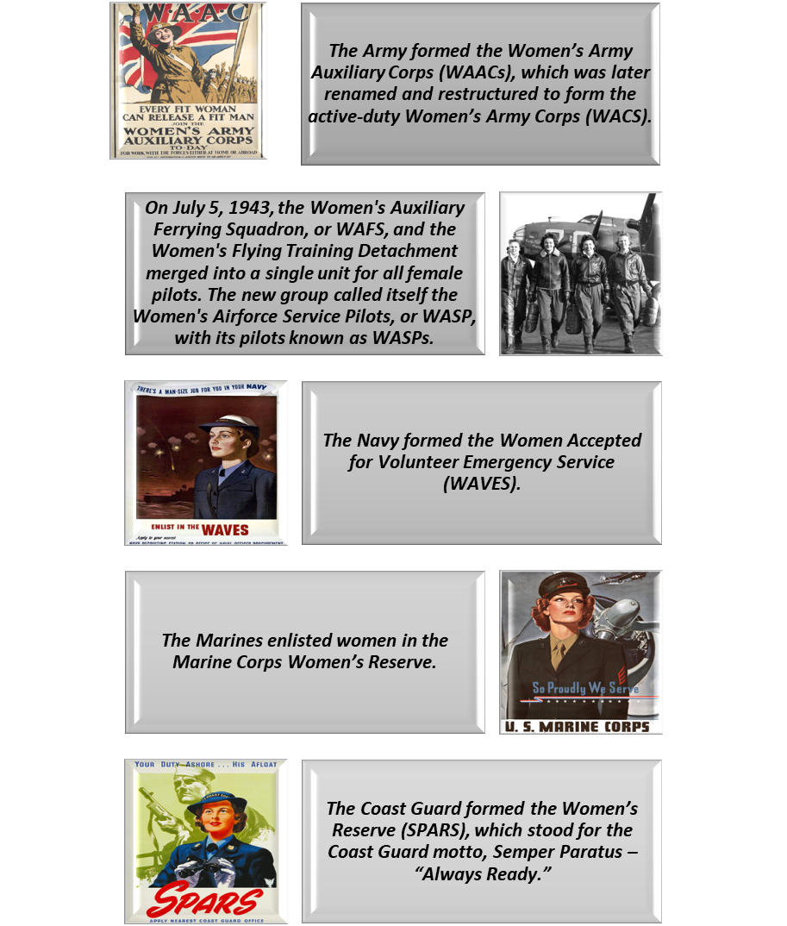
World War II (WWII)
During WWII, women started to take on non-combat roles to free up more men to fight on the frontlines. This did not stop them from also continuing their clerical jobs or working as radio and telephone operators, just like in WWI.
Some of their new roles included driving vehicles or repairing airplanes, working in laboratories, rigging parachutes, or test-flying planes. They were so knowledgeable in their new positions that they were being asked to train their male counterparts.
This war saw almost half a million women in uniform. The valuable role women played in WWII led to a big change in the military's way of thinking.

Slide 7
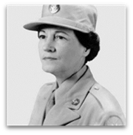
Korean War Era
1948, passage of the Women’s Armed Services Integration Act allowed women to be recognized as full members of the American military and they could claim benefits. Women who chose to serve could make a career for themselves in the Army or Navy. The downside was female service members could be automatically discharged if they became pregnant and they were unable serve in combat positions.
Regardless, this act was still a step forward for women. In addition, the Integration of the Armed Forces executive order was signed, desegregating the military and ensuring that Black women could now serve equally in all branches of the military as well.
Esther McGowin Blake was the first woman to serve in the US Air Force. Her motivation to join the military was deeply personal: both of her sons were currently serving, and Ms. Blake was widowed. With the announcement of “free a man to fight”, Blake rushed to the recruiting center, and enlisted on the first hour of the first day the Air Force announced that women would be allowed to serve. Thankfully, the end of the war saw the reunion of Blake and her two sons.

Slide 8
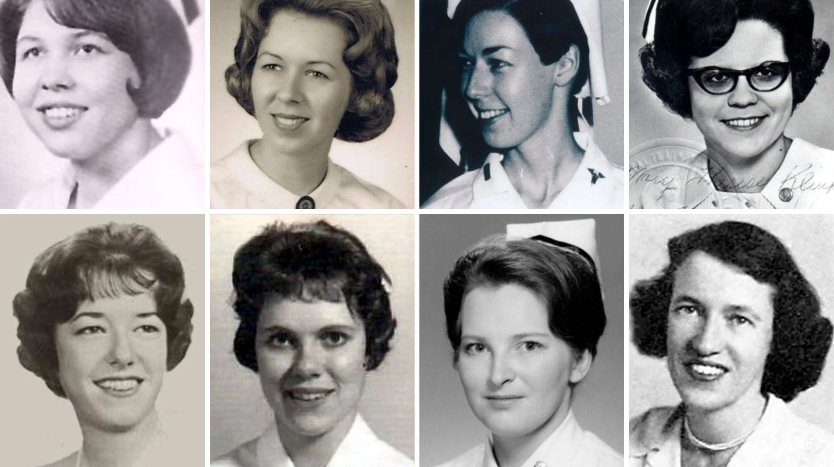
Vietnam War
While Women’s Rights were being fought for stateside and in the political arena, approximately 11,000 women, most volunteers, were deployed and stationed in Vietnam. During the nearly 20-year war, eight American women service members lost their lives (TIME, 2021) .
Other female service members worked as air traffic controllers, intelligence officers and clerks – both at home and in Vietnam. Additional changes included promotions for women to general and flag ranks and women being allowed to command units that included men.
At the end of the U.S.’ involvement in the Vietnam War, the Pentagon then announced that pregnant women could remain in the military.

Slide 9
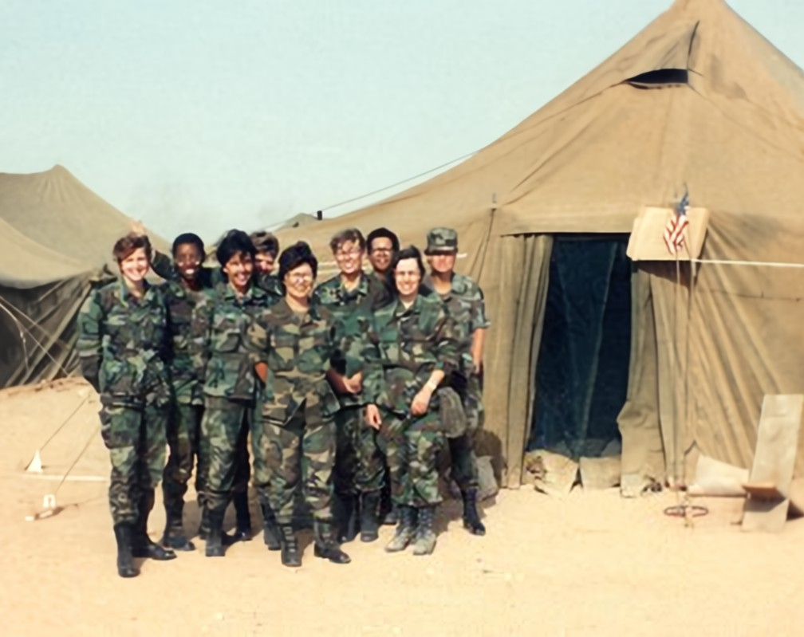
Years following, moving through war times more than 40,000 women deployed to combat zones. They drove trucks, worked as mechanics, flew troop transport helicopters, fired Patriot missiles and performed most military functions that were not officially deemed as combat roles.
Of the women who served in the U.S. forces during the Gulf War, 15 were killed and two were captured by Iraqi forces. By the end of the decade, women served on combat ships and flew warplanes from American aircraft carriers (Baker, 2020).
Women did suffer a setback in 1994, when Secretary of Defense Les Asprin refused to allow women to serve in units whose primary purpose was ground combat.

Slide 10
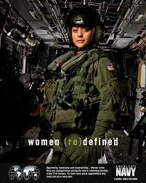
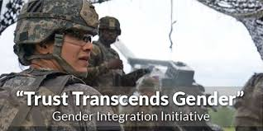
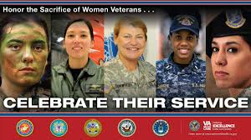
To The Future Of Women In War
The early 21st century has proved it continues to move forward for women in the military. Colonel Linda McTague became the first female commander of a fighter squadron, while women in the Army and Marines edged ever closer to full combat duty. In January 2013, Secretary of Defense, Leon Panetta, lifted the ban on women in combat roles and gave the military two years to complete integration.
In 2015, two women completed the prestigious Army Ranger School. After this, the Pentagon announced that all combat jobs must be open to women. The decision to open combat jobs to women is groundbreaking, not only because it expands the roles women can take in the military, but also because it opens opportunities for women to advance into the highest ranks of the military.
As the evolution of women in the military continues, the United States is finally moving towards fully leveraging the power, intelligence, and influence of female military leaders. Our nation is far behind other countries with the integration of women in the military, but the continued momentum shows there is no end to what women can do, what we can achieve.

Slide 11
References
Blakemore, E. (2018, June 29). How women fought their way into the U.S. Armed Forces. History.com. https://www.history.com/news/women-fought-armed-forces-war-service
Boyd, M. A., Bradshaw, W., & Robinson, M. (2013). Mental health issues of women deployed to Iraq and Afghanistan. Archives of Psychiatric Nursing, 27(1), 10–22. https://doi.org/10.1016/j.apnu.2012.10.005
Carney, C. P., Sampson, T. R., Voelker, M., Woolson, R., Thorne, P., & Doebbeling, B. N. (2003). Women in the Gulf War: combat experience, exposures, and subsequent health care use. Military medicine, 168(8), 654–661.
DeSimone, D. (2022, June 17). Over 200 years of service: The history of women in the U.S. military. United Service Organizations. https://www.uso.org/stories/3005-over-200-years-of-service-the-history-of- women-in-the-us-military
Esther Blake: First Enlisted Woman in the Air Force. Air Force. (n.d.). https://www.af.mil/News/Article- Display/Article/109629/esther-blake-first-enlisted-woman-in-the-air-force/
Godson, S. H. (2001). Serving proudly: A history of women in the U.S. navy. Naval Institute Press.
Hanson, K. (2022, March 18). The critical role of women in the military. We Are The Mighty. https://www.wearethemighty.com/military-life/role-of-women-in-the-military/

Slide 12
References cont.
Maiocco, G., & Smith, M. J. (2016). The experience of Women Veterans Coming Back from war. Archives of Psychiatric Nursing, 30(3), 393–399. https://doi.org/10.1016/j.apnu.2016.01.008
Robinson , L., & O’Hanlon, M. E. (2021, January 6). Women warriors: The ongoing story of integrating and diversifying the American Armed Forces. Brookings. https://www.brookings.edu/essay/women-warriors-the-ongoing-story-of-integrating-and- diversifying-the-armed-forces/
Schenawolf, H. (2022, March 23). Deborah Sampson: Her incredible story as a Continental soldier in the American Revolution. Revolutionary War Journal. http://www.revolutionarywarjournal.com/deborah-sampson-continental-soldier-in-the- american-revolution-disguised-as-a-man-she-fought-was-wounded-and-received-an- honorable-discharge/
Uenuma, F. (2021, May 27). The American military women who lost their lives in Vietnam. Time. https://time.com/6051363/vietnam-war-women-memorial/
Women in the American Revolution. American Battlefield Trust. (2021, August 25). https://www.battlefields.org/learn/articles/women-american-revolution

