Slide 1
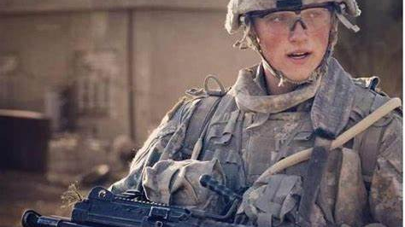
The Women of SOF
Chenal-Christine N. Roberts
University of Colorado, College of Nursing
NURS 6015 - Women and War
Dr. Lori Trego
Midterm - July 10, 2022

Slide 2
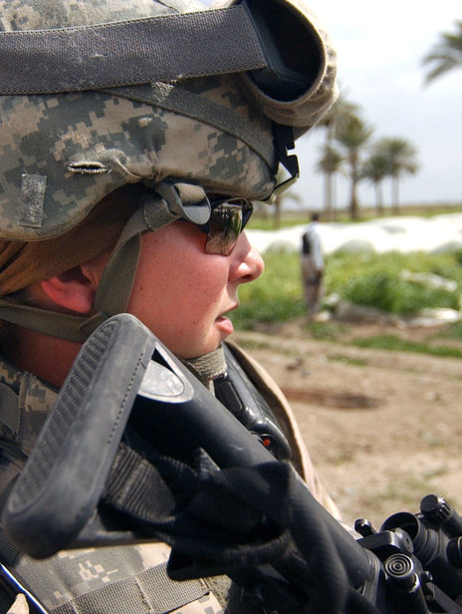
Introduction
According to Alexander (2019), the military often promotes a culture of hypermasculinity and is largely seen as a “man’s world”. This is not surprising given that the overall number of active-duty women officers and enlisted across all military services in 2019 was 16.9%, only raising slightly in 2020 to 17.2%. The higher percent of these service members were among officers, as women represent 18.9% of all officers compared to 16.9% of enlisted soldiers.
The special operations community is disproportionately affected by these stereotypes and perceptions of women service members, both active duty and reservists, who comprise an even smaller percentage of the total U.S. Special Operations Command (USSOCOM) enterprise.

Slide 3
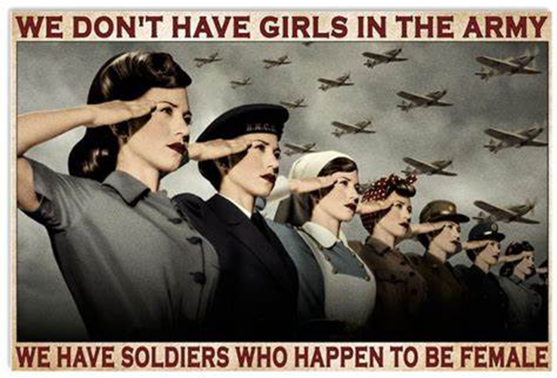
Exploring SOF

Slide 4
Branches of Special Operations Forces (SOF)
U.S. Army Special Operations Forces
U.S. Army Special Forces (Green Berets)
The quiet professionals. Masters of unconventional warfare.
Delta Force (CAG)
The Army's elite counter-terrorism experts.
75th Ranger Regiment
Army Rangers lead the way.
160th Special Operations Aviation Regiment
The Night Stalkers - elite helicopter flyers
Intelligence Support Activity
Top secret intelligence gatherers
Naval Special Warfare (NSW)
Navy SEALs
America's renowned naval commandos
SEAL Team Six
The US Navy's secretive special mission unit, known as DEVGRU
Special Warfare Combatant-craft Crewman (SWCC)
Elite sailors who operate a range
of surface boats
U.S. Air Force Special
Operations Forces
Special Operations Squadrons
Operators of AC-130 Gunships and other specialized planes and helicopters
Special Tactics Teams
Combat Controllers, Pararescue men, TACPs and Special Operations Weather Teams
USMC Special Operations
Forces / Elite Units
US Marine Corps Special Operations Command (MARSOC)
Marine SOF under a new command structure
Force Recon
Elite Marines who carry out deep reconnaissance operations
Division Recon
Highly trained Recon Marines
Coast Guard Special Ops
Deployable Operations Group
Coast Guard Specialized Forces

Slide 5
While working with the Special Operations Forces (SOF) over the last year I grew to wonder if I would only work with men in our intensive evaluation and treatment program. I was excited to see a female admission incoming, Christina. Continuing my chart review, I found we would intake Christian, a male service member instead.
For the better part of history, women have been seen as the caregivers; putting others first. How can anyone move past that? Can do their jobs without having the personal lives interfere? Another common misconception is how will a female survive in a combat situation. What if her male teammates are injured, and she needs to get them out? Or what if she’s injured, how will her male teammates respond and will they be able to keep their head in the game.
Looking into some of the reasons why this might have been assumed as truth, reasons of doubt popped up all over. If women are part of these small specialized teams and then become pregnant or have a family or medical emergency pulling them from the mission, could this put the whole unit and/or mission in jeopardy?
Female SOF?
An exploration of social perceptions of women being a part of Special Operations Forces and the myth of “Only Boys Allowed”

Slide 6
Evidence dispelling this myth.
“For example, after the Captain’s Career Course (CCC), women should not be offered the opportunity to attend Jumpmaster School while their peers are sent straight to their Airborne unit. Since schools can be prerequisites for company command, this makes those women eligible for command before their peers, who are often forced to wait in a long queue before eligibility. Not only should women not receive preferential treatment, but women should not receive additional time or opportunities to train up for SOF selections or schools.”
--Jantzi-Schlichter (2019)
Male military personnel reported concerns of women’s ability to handle the physical and leadership requirements; however, data shows that women can not only meet these requirements, but also outperform some men. The true questions being asked by male military personnel were related to the opportunities provided to women and the way of integrating into a male dominated unit without a female role model to guide them and the unit cohesion moving forward.
So far, the Air Force Special Operations Command (AFSOC) has had the most success in integrating women as leaders throughout their SOF ranks. AFSOC has female wing commanders, AFSOC operations chiefs, squadron commanders, command chief master sergeants, and first sergeants. These are just a few of the thousands of women serving as members of AFSOC.
Women are also integral members of the Army Special Operations Forces (ARSOF) and whose branches all require an assessment, selection, and qualification course pipeline. The Psychological Operations (PSYOP) and Civil Affairs (CA) branches have been open to women for decades. These branches execute core special operations tasks critical for influencing international partners, adversaries, and the local civilian populace in a dynamic threat environment and on battlefields where the demographics are continually changing.

Slide 7
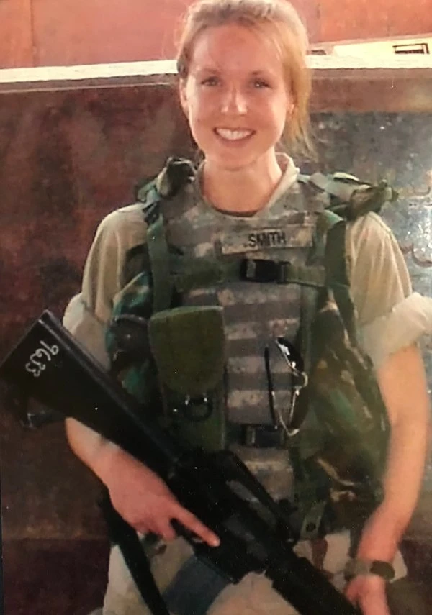
“Women have been on the front lines with special operators for 16 years, but because that community is unseen and so rarely talks about their work, it’s been hard to know how much women have done.”
-- Gayle Tzemach Lemmon (2019)
Women in the Navy have served alongside Navy SEALs for decades as enablers. The Navy has both an enlisted warfare qualification process and a series of Navy Officer Billet Codes/Additional Qualifying Designators to permanently note this in a sailor’s record. Enlisted sailors, regardless of gender, may earn the Expeditionary Warfare Specialist badge. Since 2003, officers have had the opportunity to earn these codes in their records that show both assignment and leadership roles within Navy and joint special operations units.
Women serving in these units in both leadership and frontline roles is routine. The assistant operations officer position on SEAL teams is often held by surface warfare officers and has been held by women before. Navy Lieutenant Andrea N. Goldstein, an intelligence officer, led over 60 sailors as a troop commander in one of the special reconnaissance teams (SRTs).
The Naval Special Warfare (NSW) community has two SRTs, a position once held by Senior Chief Kent. The recent tragic death of Navy Cryptologic Technician Senior Chief Shannon Kent (pictured to the right) brought to light the growing number of women in the Navy’s special operations community. Senior Chief Kent mastered signals and human intelligence and throughout five combat deployments persuaded government and tribal leaders, along with merchants and soldiers, to give her information. Her intelligence work eventually led to the death and capture of some of America’s most wanted foreign adversaries.
“She was a woman in SOF before there were women in SOF”. –Joe Kent, husband and retired SOF.

Slide 8
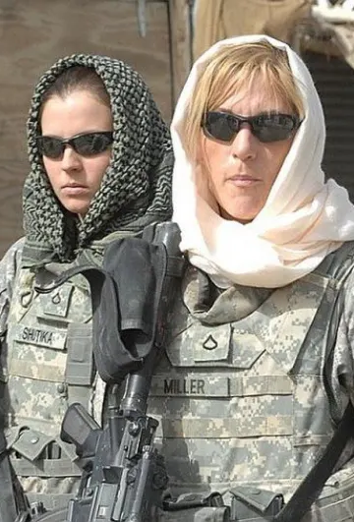
Fast Facts:
Female SOF members making a difference
Lieutenant Colonel Allison Black “Angel of Death” In 2001, she flew an AC-130 gunship providing critical cover and fire to the U.S. SOF teams and the Afghanistan’s Northern Alliance fighters battling Northern Afghanistan’s insurgents.
Additionally, she has gone on to serve in leadership roles across AFSOC, such as the 319th Special Operations Squadron commander.
Chief Master Sergeant Hope Skibitsky is the first woman to hold the position of the Command Chief for 27th Special Operations Wing.
Now she is the senior enlisted adviser to the AFIMSC commander, overseeing the health, welfare and professional development of 3,900 total force Airmen and help guide the center responsible for delivering installation and mission support capabilities across the Air and Space Force.
Colonel Tracy Onufer is an electronic weapons officer and current Special Operations Command Chief of Staff.
Colonel Shelly Rodriguez is an MC130P/J pilot and has commanded in various positions throughout AFSOC.
Doctors like Major Regan Lyon fill the critical role of saving lives on special operations surgical teams, treating patients on everything from a stretcher in a house to a CV-22 Osprey aircraft.
Colonel Bethany Aragon, the 4th PSYOP Group (Airborne) commander oversees over 700 soldiers serving around the world.
Colonel Aragon trained and led PSYOP soldiers in Africa. Under her command, soldiers analyzed antagonist social media operations and directly influenced civilian populations to alter behavior.
1st Lt. Jennifer M. Moreno, killed in Kandahar while attached to a U.S. Army 75th Ranger Regiment.
Moreno began her military career as an army nurse, volunteered with U.S. Army Special Operations Command after completing Army airborne training in 2009. Assigned to the Cultural Support Team, she was one of the female troops serving to search women in countries such as Afghanistan where interaction between women and men they are not related to is socially unacceptable.

Slide 9
News Stories Around the World
WORLD
Inside the World's First All-Female Special Forces Unit: Norway's Jegertroppen
Norway has moved a lot faster than the U.S. to break down military gender barriers, boasting the world's first all-female special forces unit.
April 16, 2017, 4:20 AM PDT
By Carlo Angerer
137th CTF hosts first female student
Published June 8, 2022
By Tech. Sgt. Brigette Waltermire
137th Special Operations Wing
WILL ROGERS AIR NATIONAL GUARD BASE, Okla. -- The 137th Combat Training Flight hosted its first female student in the joint terminal attack controller qualification course.
Did you know?
AT WAR: The True Story of the First Woman to Finish Special Forces Training Forty years ago, Capt. Kate Wilder passed the Army Special Forces Officer Course, but her superiors wouldn’t let her graduate with her peers.
By John Ismay, Feb. 28, 2020
The Times reported that a National Guard soldier was set to become the Army’s first female Green Beret since the Pentagon’s opening of all combat jobs to women in 2016. She’ll be the first woman in history to finish the yearlong qualification course and be assigned to a Special Forces operational detachment. But 40 years earlier, another woman passed the course and fought for her right to be recognized.
Female Soldier Graduates Special Forces Qualification Course
By USASOC PUBLIC AFFAIRS OFFICE July 9, 2020
FORT BRAGG, N.C. – U.S. Army Special Operations Command confirms the first female Soldier graduated on July 9, 2020 at a COVID-compliant graduation ceremony for the Special Forces Qualification Course.
BUSINESS
Special Ops Survey Showed 85% Opposed Serving With Women. If integration of women is going to work, special operations leaders will have to convince the rank-and-file.
BY GAYLE TZEMACH LEMMON
COUNCIL ON FOREIGN RELATIONS
DECEMBER 4, 2015
PERSONNEL DEFENSE DEPARTMENT SPECIAL OPERATIONS
Come next year women can become Navy SEALs and Army Rangers should they meet the test requirements, Defense Secretary Ash Carter announced Thursday.

Slide 10

No matter how far we have come, or the huge strides made over time, women continue to struggle daily with having to prove their worth, their ability to perform, and their ability to maintain within the male dominated world of the US military. There are so many women who have fought to save lives, who have proved their worth over and over making history yet are hardly known today unless spoken about in classes like ours. Here are some of the most inspirational women I’ve been lucky enough to discover.
Joan of Ark
Margaret Corbin
(The Revolutionary War)
“Battalion of Death”
(WWI all female unit)
Lydia Litvyak and Lyudmila Pavlichenko (WWII)
Cdr. Elizabeth Barrett and 1st Lt. Sharon Ann Lane
(Vietnam War)
Annie G. Fox first woman in American military history to ever receive a Purple Heart after treating hundreds during the Japanese air born attack of Pearl Harbor
Lt. Gen. Patricia Horoho recognized as the first nurse and woman to be nominated and confirmed as Army Surgeon General.
Margaret Woodward, USAF pilot and Time Magazine’s 100 most influential people of 2011. Additionally, she led the reform of the U.S. military’s sexual assault prevention and response protocols, assembling a task force of expert lawyers, researchers, investigators, and advocates who are responsible for addressing the issue of sexual assault within the military.
Major April Moore recognized as the top SOF graduate from the U.S. Army’s Command and General Staff College, leading CA teams in combat, and worked alongside the interagency community in responding to the Syrian crisis.
Lieutenant Colonel (retired) Angela Greenwald formerly of the 96th CA Battalion, commanded hundreds throughout the Middle East, Afghanistan and Pakistan.

Slide 11

What’s next?

Slide 12
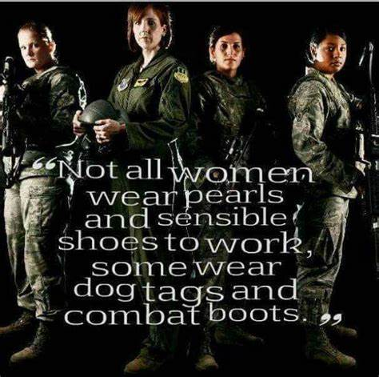
I would tell people, “Oh, I'm doing a story on U.S. Special Operations.” And they'd say, “That's amazing!” … everybody had seen American Sniper and Lone Survivor. And then I'd say, “This story has women in it.” And their next question would be, “So is it about rape or PTSD?”
-- Gayle Tzemach Lemmon, 2016

Slide 13
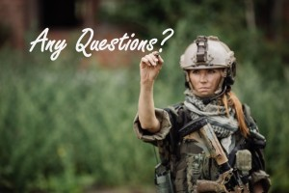

Slide 14
References
Alexander, N., & Kohistancy, L. (2019). Dispelling the myth of women in special operations. CNAS Military, Veterans and Society Program Series: Supporting the Military Community. https://www.cnas.org/publications/commentary/dispelling-the-myth-of-women-in-special-operations
Integration of women in SOF Units. SOFREP. (2020, February 22). https://sofrep.com/news/integration-of-women-in-sof-units/
Jantzi-Schlichter, J. (2019, September 11). Integration of women in SOF - the U.S. perspective. Stratagem. https://www.stratagem.no/integration-of-women-in-us-sof/
Lemmon, G. T. (2021, April 11). Special ops survey showed 85% opposed serving with women. Defense One. https://www.defenseone.com/business/2015/12/special-ops- survey-showed-85-opposed-serving-women/124194/
Master Sgt. Amaani Lyle, S. of the A. F. P. A. (2011, March 23). They called her 'The angel of death’. The American Legion https://www.legion.org/washingtonconference/98498/they-called-her-angel-death
Oppel, R. A. (2019, February 8). Her Title: Cryptologic Technician. Her Occupation: Warrior. New York Times, p. 4.
Sof, E. (2022, March 31). Tier 1 operators said “No” to women in special operations forces units, but…. Spec Ops Magazine. https://special-ops.org/tier-1-operators-said-no-to- women-in-special-operations-forces-units/.
Strickler, Jeff DHA, RN, NE-BC Clara Barton, Nursing: March 2018 - Volume 48 - Issue 3 - p 43-45 doi: 10.1097/01.NURSE.0000529805.60418.26
Szayna, T., Larson, E., O'Mahony, A., Robson, S., Schaefer, A., Matthews, M., Polich, J., Ayer, L., Eaton, D., Marcellino, W., Miyashiro, L., Posard, M., Syme, J., Winkelman, Z., Wright, C., Zander-Cotugno, M., & Welser, W. (2015). Considerations for integrating women into closed occupations in the U.S. Special Operations Forces. https://doi.org/10.7249/rr1058
Turnley, Jessica Glicken, Dona J. Stewart, Rich Rubright, Jason Quirin. Special Operations Forces Mixed Gender Elite Teams. MacDill AFB, FL: JSOU, 2016.

Slide 15
References cont.
US Special Operations Command - U.S. Department of Defense. (n.d.). https://dacowits.defense.gov/Portals/48/Documents/General%20Documents/RFI% 20Docs/June2017/SOCOM%20RFI%202.pdf
Women in ground combat: Facts and figures (02/01/2017 - swan. (n.d.). http://www.servicewomen.org/wp-content/uploads/2017/02/Women-in-Ground- Combat-Arms-Fact-Sheet-2-1-17.pdf
13 Aug 2013 Marine Corps News. (2021, July 1). Services open combat and SOF Jobs for women. Military.com. Retrieved July 2, 2022, from https://www.military.com/special- operations/2013/08/13/services-open-combat-and-sof-jobs-for-women.html
26, A., & Dudley, W. (2016, April 26). Special ops women: A conversation with Gayle Tzemach Lemmon. RAND Corporation. https://www.rand.org/blog/rand-review/2016/04/special- ops-women-a-conversation-with-gayle-tzemach.html

