Slide 1
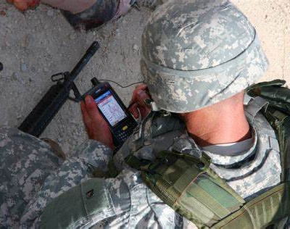
ARMOR Action in Realtime – Mobile Operator Records
Chenal-Christine N. Roberts University of Colorado, College of Nursing NURS 6025 (C01) – VMHC Internship Dr. Mona Pearl Treyball Fall 2023

Slide 2
The Problem and the Needs
Create a tracker allowing for personal documentation
Pinpoint body shape what was injured or affected, for how long, and what were the symptoms at time of and post incident/injury.
Date and location stamped to help validate
Like the “buddy statements” in the Vietnam days.
SOF members would be able to benefit giving them real-time access and structured organization to help track incidents and injuries.
While working with the Special Operations and Special Forces (SOF) service members over the past couple of years, I’ve been alerted to the memory issues, lack of documentation of incidents that occurred over their career, and the lack of knowledge remembered/documented at or around time of incident.
Notes:
While working with the Special Operations and Special Forces (SOF) service members over the past couple of years, I’ve been alerted to the memory issues, lack of documentation of incidents that occurred over their career and the lack of knowledge remembered/documented at or around time of incident.
My plan is to create a tracker that will allow these service members to document and pinpoint on their person what was injured or affected, for how long, and what were the symptoms at time of and post incident/injury. then transition to a mobile type application (app) This can also be date stamped and possibly location stamped to help validate the report, kind of like the “buddy statements” in the Vietnam days. These reports are being used for Veterans needing support on their claims for VA disability and benefits.
SOF service members would be able to benefit from this app because it will give them real-time access, ability and structured organization to help start tracking incidents and injuries they receive, especially while on deployment.

Slide 3
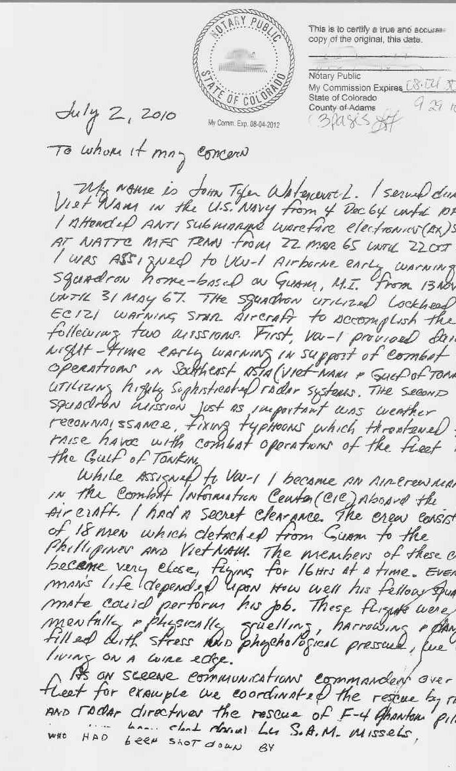
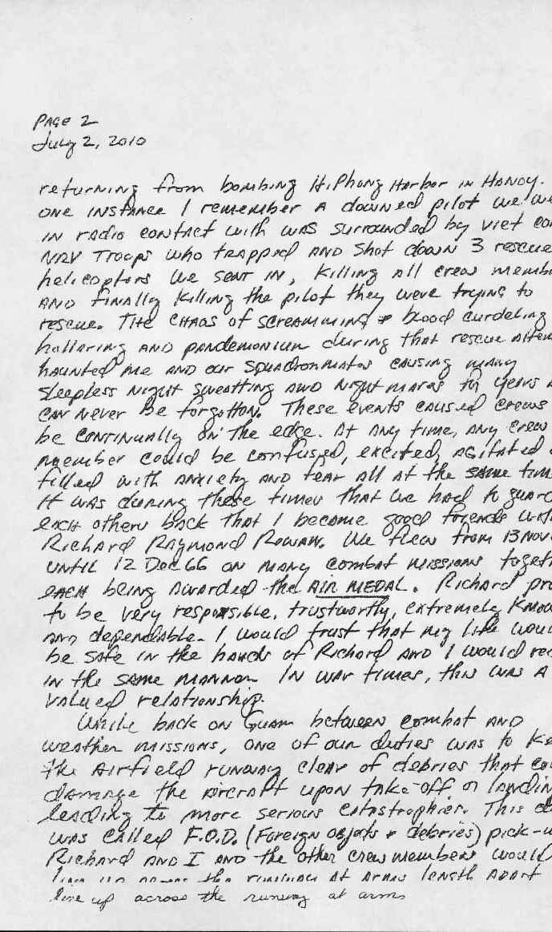
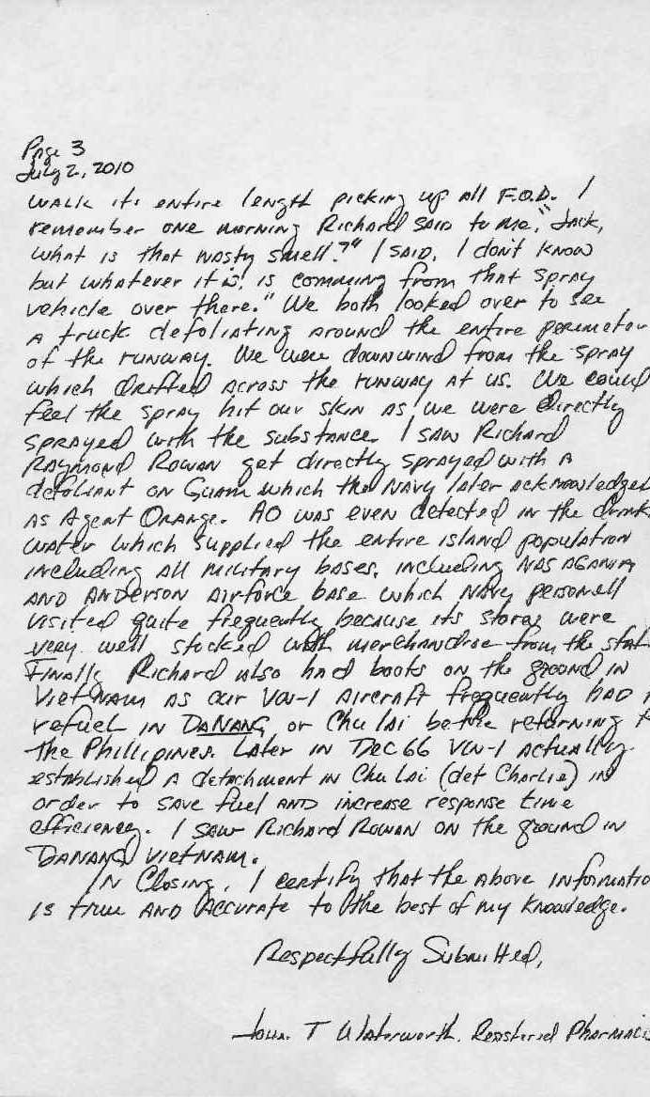
Buddy Statements for VA benefits
A 3-page handwritten buddy letter dated 07 July 2010 from Jack Waterworth AX2 VW-1 1965 - 1967 to the VA on behalf of Richard Rowan AG3 VW-1 1964 - 1966. In this letter Jack verifies that he was with Richard in Vietnam while assigned to VW-1. He also relates how one mission in particular affected him and other crewmen after they vectored in 3 rescue helos to bring back a F4 crew who had bailed out of their plane. It apparently was a trap that resulted in the loss of all 4 crews and aircraft. Jack also recalls when VW-1 squadron members were hit with Agent Orange from a sprayer while performing a FOD walk down at NAS Agana.
Copy provided by Richard Rowan AG3 VW-1 1964 - 1966

Slide 4
Literature review
Keywords/Search concepts:
special operations forces AND brain injury
special operations AND military AND brain injury
combat AND brain injury AND exposure
self report AND military AND active-duty
self report AND active-duty service member AND brain injury
Databases used:
CINAHL
PUBMED
Google Scholar

Slide 5
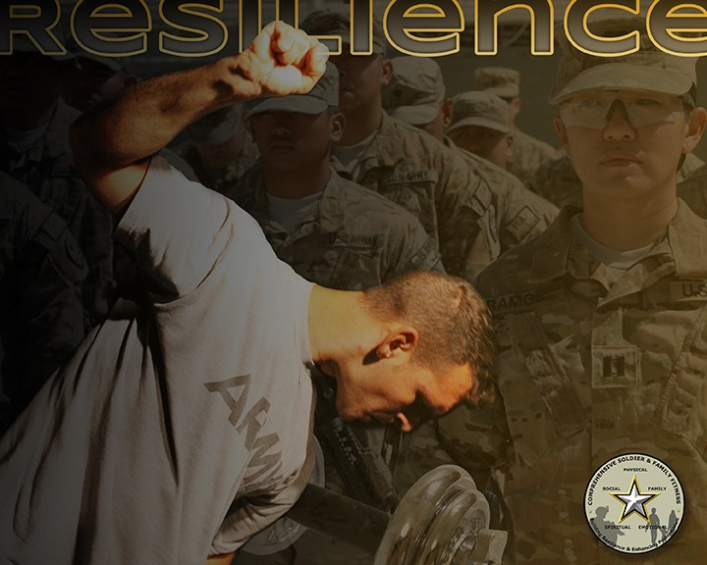
Literature Review Themes
“self-report measures”
“military veterans of OEF/OIF”
“medical and behavioral health care needs”
“Prevalence of self-reported symptoms”
“reporting of symptoms”

Slide 6
PICO
Is a medical tracker of injuries/symptoms for Special Operation Forces practical/feasible to use during military training?

Slide 7
Conceptual Framework and Theory Guided Approach
Newman’s Health as Expanding Consciousness
Based on Roger’s theory, focus includes the health of all people, regardless of the presence or absence of disease.
Asserts that every person in every situation, no matter how disordered and hopeless it seems, is part of the universal process of expanding consciousness.
Pender’s The Health Promotion Model
Focuses on three areas: individual characteristics and experiences, behavior-specific cognitions and affect, and behavioral outcomes.
Each person has unique personal characteristics and experiences that affect them uniquely.
Roger’s Theory of Unitary Human Beings
Patients cannot be divided into parts but must be looked at as a whole
Address the importance of the environment as an integral part of the patient.
Knowledge to help nurses blend the science and art of nursing to ensure patients have a smooth recovery.

Slide 8
Conceptual Framework
Newman, Pender’s and Roger’s Theories overall: Individuals are unique and indivisible, viewing health as a holistic experience.
Health Promotion:
Pender’s Health Promotion Model is integrated into the framework, emphasizing the proactive role of individuals in promoting their own health. This includes a focus on self-efficacy, motivation, and personal choices in achieving and maintaining well-being.
Holistic Approach:
The framework promotes a holistic approach to health, recognizing that physical, mental, emotional, and spiritual dimensions are interrelated and should be considered.
Nursing Practice:
In the context of nursing practice, this framework encourages healthcare professionals to consider the uniqueness of everyone, support their journey of expanding consciousness, and facilitate their active participation in health promotion activities.

Slide 9
My Theoretical Framework Individuality and holistic perspective of Roger’s Theory, Growth-oriented approach of Newman’s theory, Active engagement in health promotion advocated by Pender’s model. All build towards the mission of acknowledging one's experiences, validating their symptoms and an overall personal take away to guide a comprehensive overview of their health and a voice guiding their future healthcare.

Slide 10
Roger’s Theory of
Unitary Human Beings
+
Newman’s Health as
Expanding Consciousness
+
Pender’s The Health
Promotion Model
=
ARMOR
Capturing today to help
with your tomorrow.

Slide 11
Implementation
Purpose
Educate, empower and help personalize SOF health and wellbeing while active duty
Target Group
SOF active-duty personnel
Goal
Educating and empowering SOF service members with the knowledge of their injuries and symptoms, promoting self advocacy, leading to a personal health literacy

Slide 12
Phases of Implementation
Create template and written tracker
Revisions
Create and implement written or mobile tracker application
Problem solving how to help SOF with tracking their injuries and symptoms during their service
Connecting with sof leadership and advocating for the purpose of tracking
TRIALING TRACKERS AND EDUCATING OF THE IMPORTANCE

Slide 13
Create categories for tracker with body outline
Make them small enough for pocket and laminate to prevent job/environment damage
Connected with SWCC operator and coordinate with a training team to disseminate trackers
Provide survey to be dispersed after training exercise
Connect with Naval Special Warfare Center (NSWCEN) CMDCM (SWCC) for guidance on access to a team and implementation of project
Work with SWCC on revising tracker information and ways of implementation
Continue to work on best ways of implementing for each team (i.e. water proofing, written vs mobile application, during or after tracking)
Work on wording and clear concise categories for ease of understanding and tracking appropriate information for each different command and specific individual
Determining the best time to implement and if initating in training phase vs experienced SOF using during daily/weekly trainings and deployments.
Continue to revise according to feedback and comments provided by the users.

Slide 14
App/tracker design process
Service members were creating a list with a provider about their injuries and other related items from their time in service and how it affected their health.
Creating an app would allow visualization and personalization of their hx, exposures, injuries
Allows for future medical follow up and understanding of hazmat exposures, combat tours, etc.
Utilizing a 3D body helps brain visualize injuries and/or treatments showing specifically where on the body

Slide 15
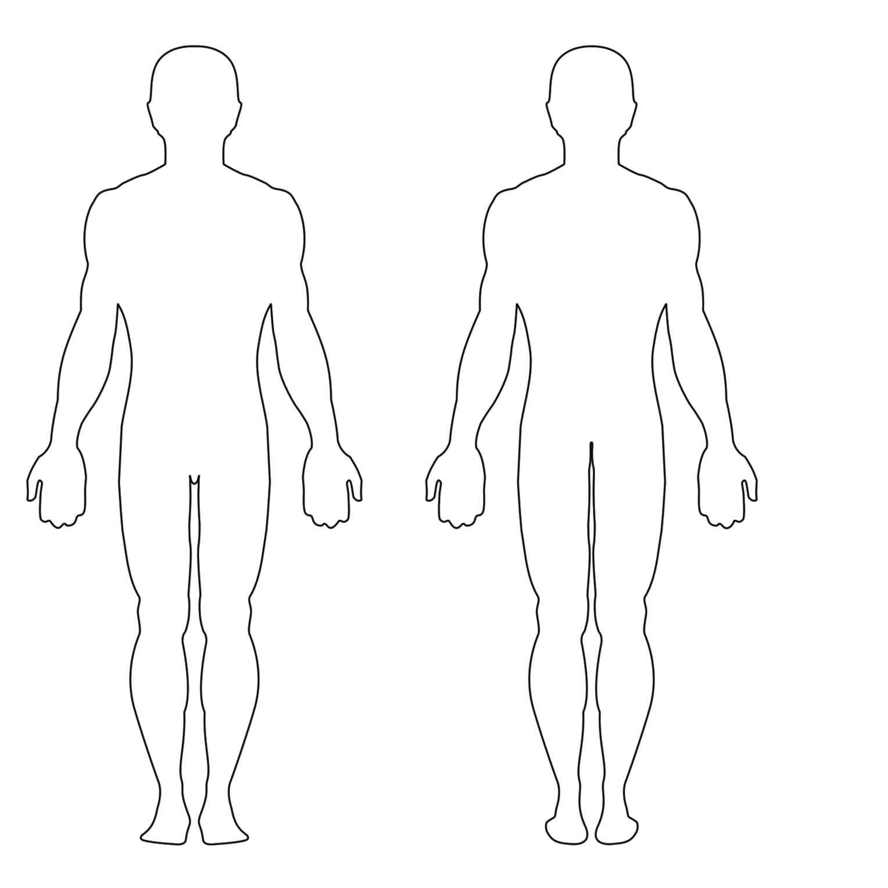
Illustrate/mark with arrow and a number on body (front and back view) to show areas affected each day.
Take notes as detailed or as concise as you feel necessary to be able to understand later in the future.
Front/Anterior
Back/Posterior

Slide 16
Location: Date: Time:
Exposures include proximity/type/duration
Injuries/illness (mark or number on body and make notes here)
Symptoms/duration
Environment:
water conditions □ desert conditions □ other □
Nausea/vomiting
Headache
Vision changes
Hearing changes
Loss/altered level of consciousness – lightheaded/dizzy/ “seeing stars”
Other: what did you feel and for how long?
Sounds:
guns □
explosives □ other □
Materials/smells: burn pits □ gas □ lead/ammunition □ Other □
Were you wearing protection?
Ears □ Eyes □
Mask □ other □

Slide 17
Survey post implementation
How many times did you use the tracker?
If tracker was used, when did you complete it?
During your training □ After training □
How many injuries/illnesses were captured?
How many exposures did you track?
Was this notebook easy to access during training:
Yes □ No □
Comments:
Was it easy to use?
Yes □ No □
Comments:
Would you add or change anything on/in the tracker?
Yes □ No □
Do you see value in this tracker?
Yes □ No □
Any additional feedback or comments?

Slide 18
Results/discussion

Slide 19
Limiting factors
Costs/funding
“the good old days” mentality
Access/connections
Security clearance
Promotional ladder/role expectations

Slide 20
Future recommendations
Possibilities in the making….
Visualization by documenting on the body and taking notes/ descriptions of events allows the individual the options to highlight a body part and report.
Document externally and internally, click boxes/drop down menus for the area, incident/injury according to the persons personal discretion.
Ability to track for things such as blasts, MVA, falls, GSW’s, training accidents, etc.
Continue to revise and implement a tracker that fits the needs of this population and to create a more in-depth tracker for the ability to “see” inside and outside. Also, to determine if written form is more applicable then mobile.

Slide 21
Application for an Advanced Practice Nurse in VMHC
Advocation
Integration
Engagement
Implementation
Transition written tracker to a mobile type application (app)?
Would this allow for ease of transfer to computers for memory?
SOF service members would be able to benefit from this app because it will give them real-time access and structured organization to help start tracking incidents and injuries they receive, especially while in trainings and on deployment.

Slide 22
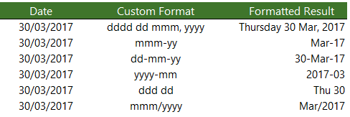
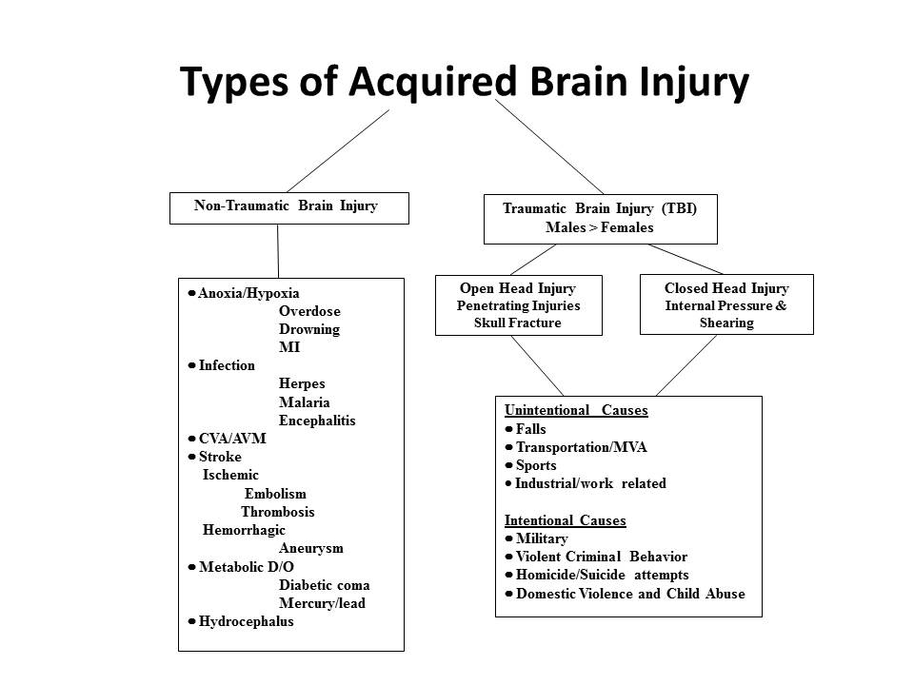
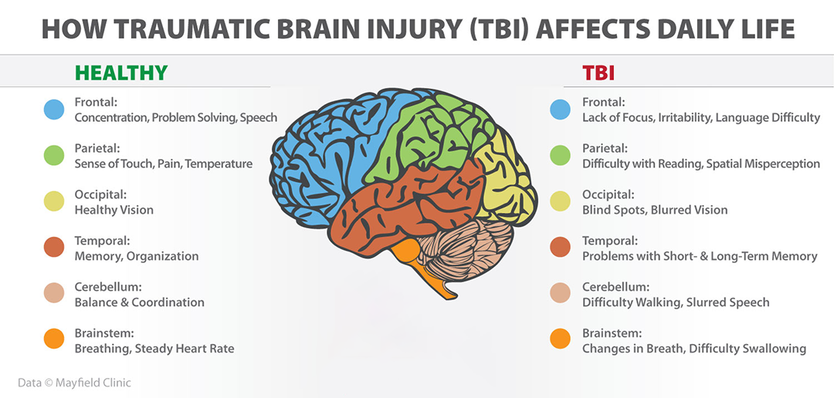
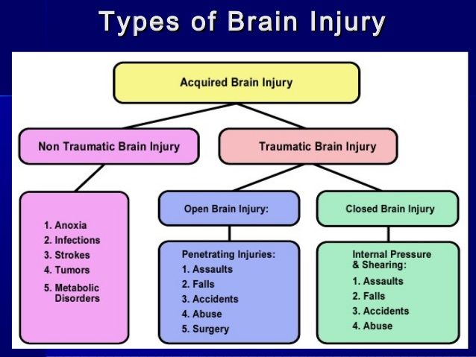
App tracker Materials and data
Needs to create app for creating
Mobile device with ability to document, even offline and with or without Wi-Fi capability.
Ability to show a 3d human body anteriorly/posteriorly and externally/internally.
Show the body parts, front or back, and if it was superficial, skin deep or possibly internal.
Ability to select phrases/specific word (i.e., body part/area of concern) and then have drop down options to what they are reporting.
Need specific info and side effects for full body related to burns, blasts, GSW, vehicle accidents, hazmat exposure, etc.

Slide 23
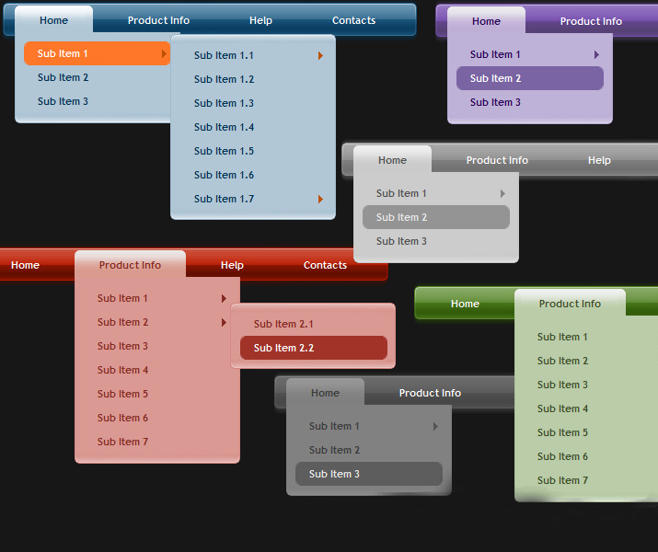
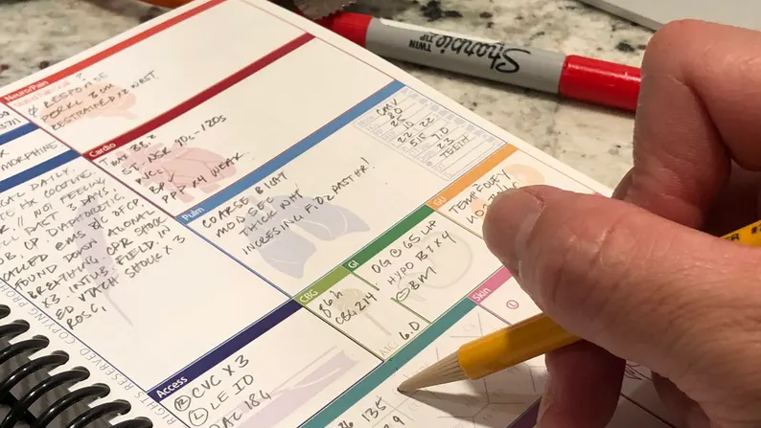
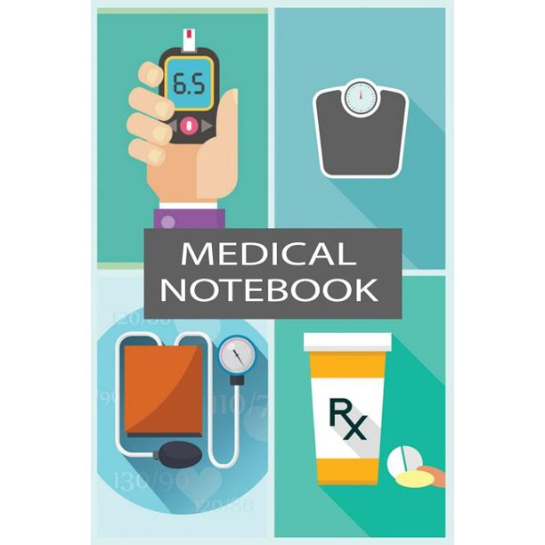
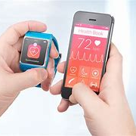
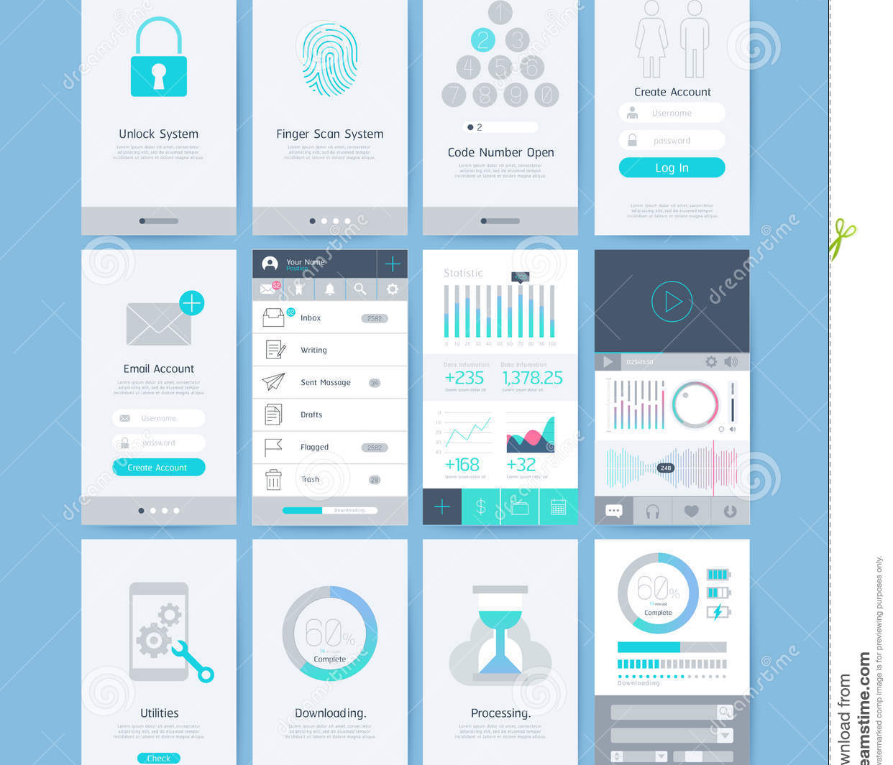
Option to fill in as much as they want or as little as they want with the opportunity to take notes, possibly immediately following the injury/incident.
Ability to add to this documentation later.
Formatted to military time with codes only understood through military personnel.
Utilize it for possibly tracking sleep hygiene, medication management, etc.
Could possibly be linked to their smart watches, transferred to secure email or military medical commands.
Add “legacy contact” to allow for specific person to access on behalf of the individual

Slide 24
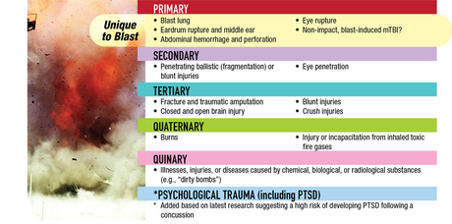
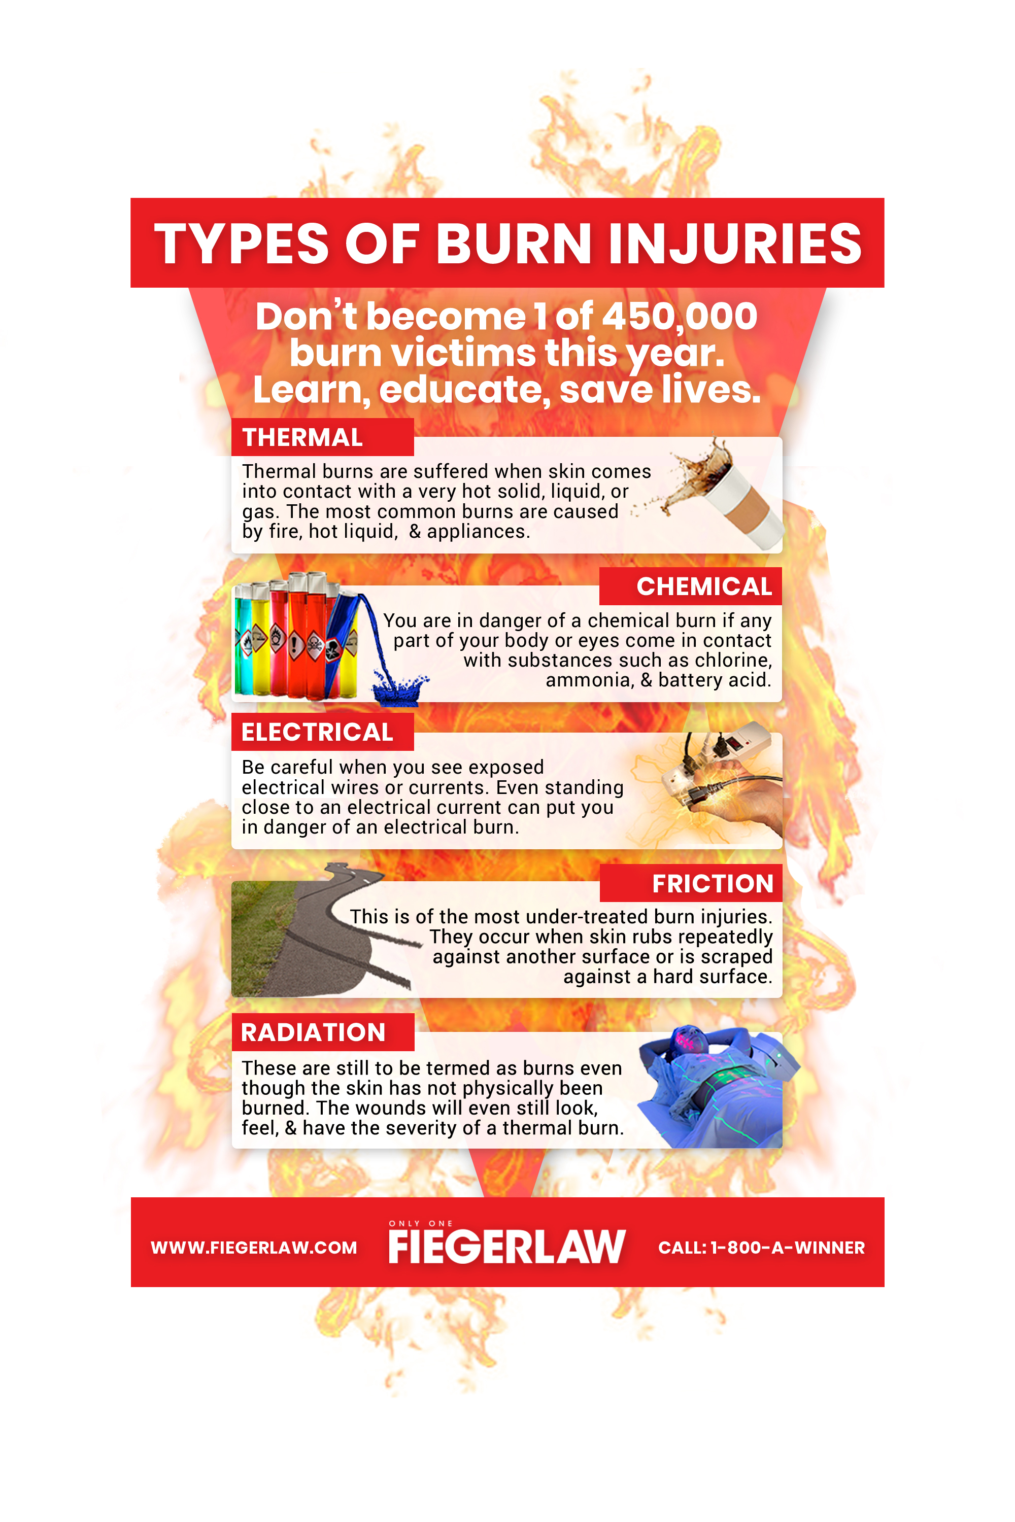
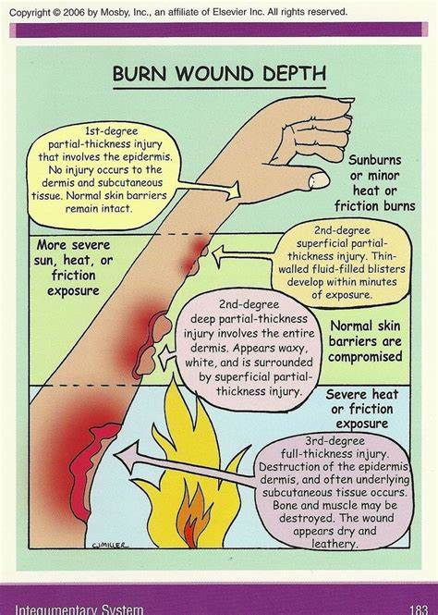
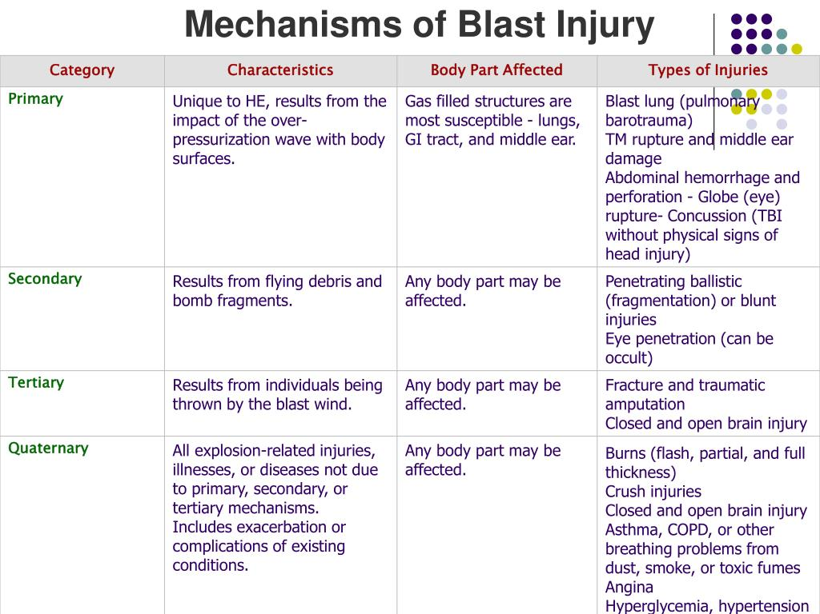
Continued tracker Materials and data

Slide 25
References:
Betthauser, L. M., Bahraini, N., Krengel, M. H., & Brenner, L. A. (2012a). Self-report measures to identify post traumatic stress disorder and/or mild traumatic brain injury and associated symptoms in military veterans of Operation Enduring Freedom (OEF)/operation iraqi freedom (OIF). Neuropsychology Review, 22(1), 35–53. https://doi.org/10.1007/s11065-012-9191-4
Blais, R. K., Tirone, V., Orlowska, D., Lofgreen, A., Klassen, B., Held, P., Stevens, N., & Zalta, A. K. (2021). Self-reported PTSD symptoms and social support in U.S. military service members and Veterans: A meta-analysis. European Journal of Psychotraumatology, 12(1). https://doi.org/10.1080/20008198.2020.1851078
Eskridge, S. L., Watrous, J. R., McCabe, C. T., Clouser, M. C., & Galarneau, M. R. (2020). The relationship between self- reported physical functioning, mental health, and quality of life in service members after combat-related lower extremity amputation. Disability and Rehabilitation, 44(13), 3189–3195. https://doi.org/10.1080/09638288.2020.1863481
Frueh, B. C., Madan, A., Fowler, J. C., Stomberg, S., Bradshaw, M., Kelly, K., Weinstein, B., Luttrell, M., Danner, S. G., & Beidel, D. C. (2020). “Operator syndrome”: A unique constellation of medical and behavioral health-care needs of military special operation forces. International Journal of Psychiatry in Medicine, 55(4), 281–295. https://doiorg.proxy.hsl.ucdenver.edu/10.1177/0091217420906659
Garcia, A., Kretzmer, T. S., Dams-O’Connor, K., Miles, S. R., Bajor, L., Tang, X., Belanger, H. G., Merritt, B. P., Eapen, B., McKenzie-Hartman, T., & Silva, M. A. (2021). Health conditions among special operations forces versus Conventional Military Service members: A VA TBI model systems study. Journal of Head Trauma Rehabilitation, 37(4). https://doi.org/10.1097/htr.0000000000000737
Hruby, A., Lieberman, H. R., & Smith, T. J. (2020). Behavioral correlates of self-reported health status in US Active-Duty Military. Preventive Medicine, 131, 105930. https://doi.org/10.1016/j.ypmed.2019.105930

Slide 26
References cont.
Jackson, C. E., Nordstrom, L., Fonda, J. R., Fortier, C. B., Milberg, W. P., & McGlinchey, R. E. (2017). Reporting of symptoms associated with concussion by OEF/OIF/OND veterans: Comparison between research and clinical contexts. Brain Injury, 31(4), 485–492. https://doi.org/10.1080/02699052.2017.1280740
Kegel, J. L., Kazman, J. B., Clifton, D. R., Deuster, P. A., & de la Motte, S. J. (2021). Self-reported health indicators in the US Army: Longitudinal analysis from a Population Surveillance System, 2014‒2018. American Journal of Public Health, 111(11), 2064–2074. https://doi.org/10.2105/ajph.2021.306456
Mysliwiec, V., McGraw, L., Pierce, R., Smith, P., Trapp, B., & Roth, B. J. (2013). Sleep disorders and associated medical comorbidities in active duty military personnel. Sleep, 36(2), 167–174. https://doi.org/10.5665/sleep.2364
Nelson, N. W., Hoelzle, J. B., McGuire, K. A., Sim, A. H., Goldman, D. J., Ferrier-Auerbach, A. G., Charlesworth, M. J., Arbisi, P. A., & Sponheim, S. R. (2011). Self-report of psychological function among OEF/OIF personnel who also report combat- related concussion. The Clinical Neuropsychologist, 25(5), 716–740. https://doi.org/10.1080/13854046.2011.579174
Sarmiento, K., Waltzman, D., Daugherty, J., Okoro, C. A., & Proescholdbell, S. (2022). Association between self-reported disability and lifetime history of traumatic brain injury with loss of consciousness among veterans and nonveterans in North Carolina. Journal of Head Trauma Rehabilitation, 37(6). https://doi.org/10.1097/htr.0000000000000753
Sherlock, L. P., Gibson, K. J., Talian, D. S., & Lake, D. C. (2023). Prevalence of self-reported bothersome tinnitus in U.S. Army soldiers from January 1, 2015, through September 30, 2019. American Journal of Audiology, 32(2), 323–333. https://doi.org/10.1044/2022_aja-22-00201
Wasmund, P. (2011, September 3). Letters etc. Information courtesy Jack Waterworth VW-1 1965 - 1967 & Richard Rowan VW-1 1964 - 1966. Letters etc.. https://vw1assoc.org/letters_etc.html

